Slide 1
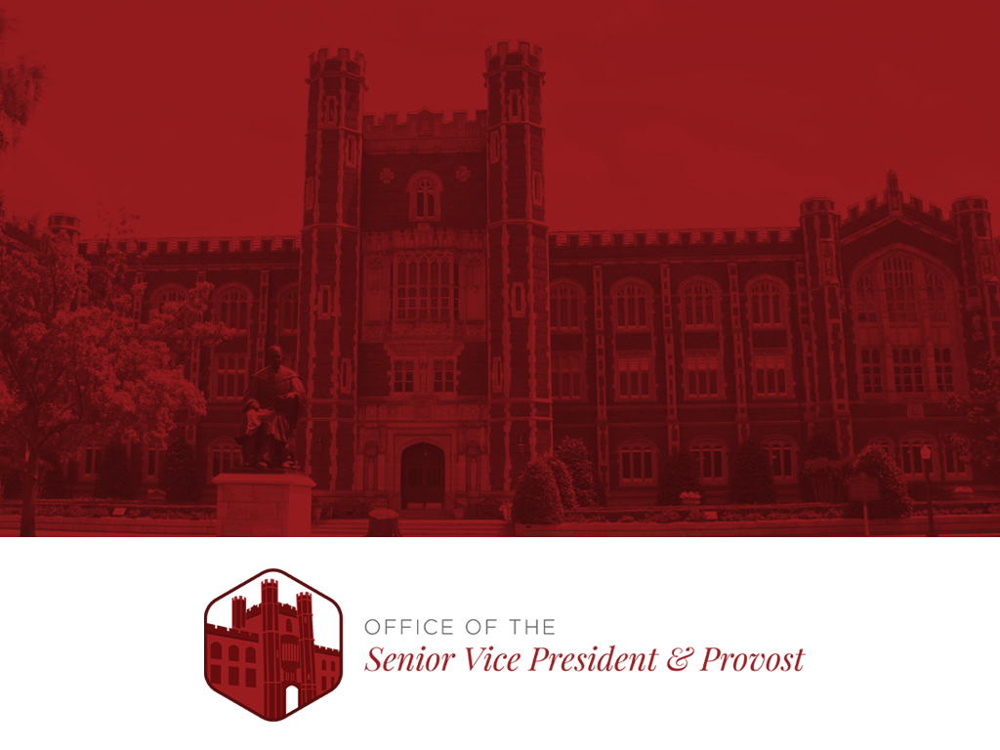
Understanding OU’s Budget & Finances
Norman Campus
Stewart Berkinshaw|sberkinshaw@ou.edu

Slide 2
What We’ll Cover
Budget Information
Sources and Uses of Funds
Key Financial Metrics

Slide 3
Budget Information
Visit the following link for short budget onboarding videos and various annual operating budget reports: https://www.ou.edu/budget/general_information/background-facts

Slide 4
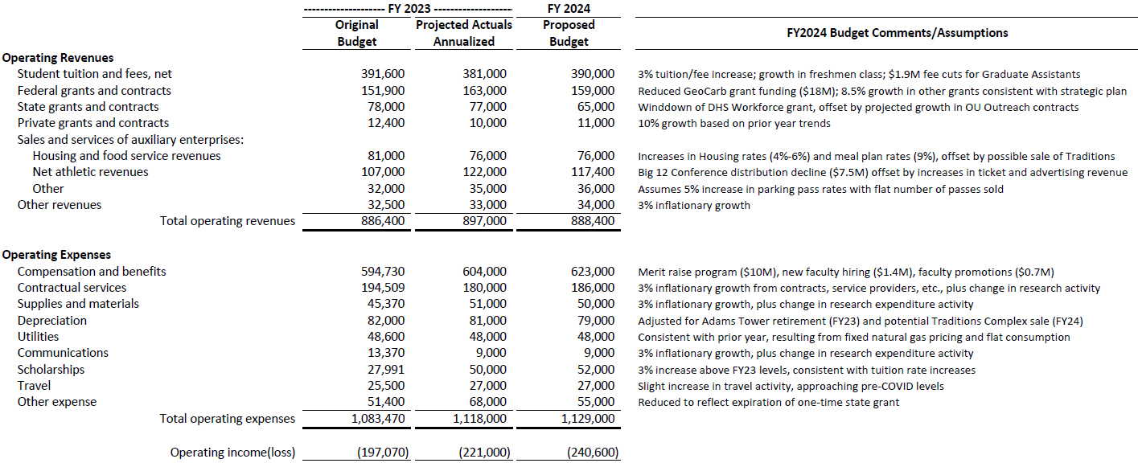
FY24 Operating Budget
($ in thousands)
See next page for page 2 of 2 of Operating Budget

Slide 5
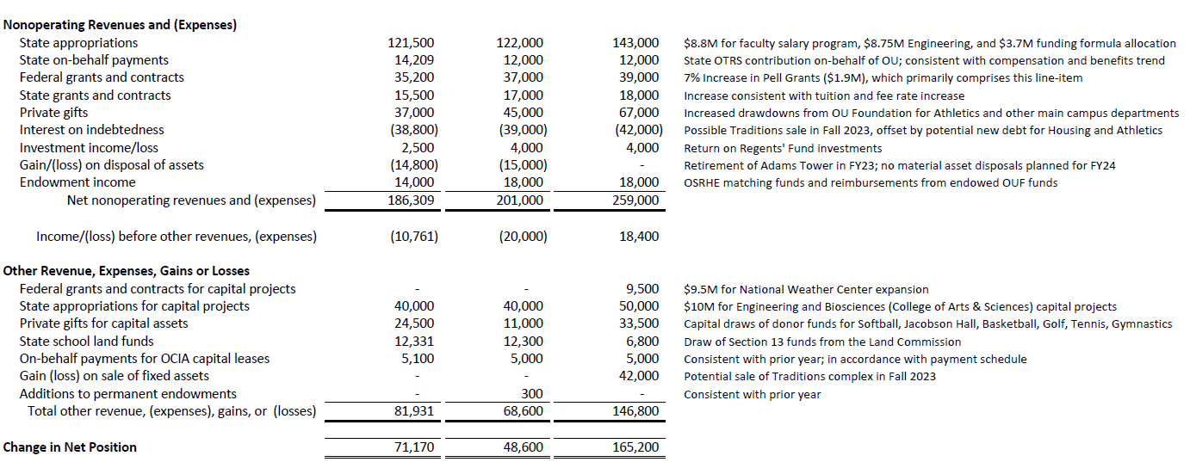
FY24 Operating Budget
($ in thousands)

Slide 6
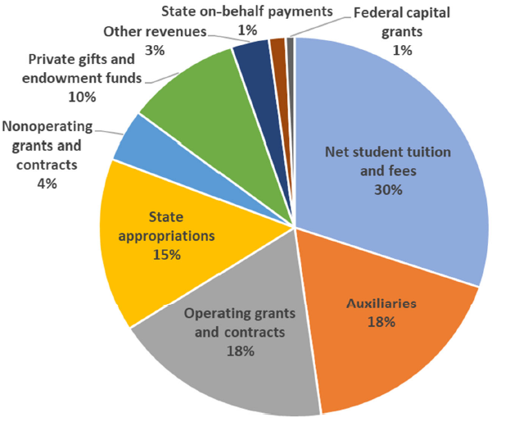
FY24 Budgeted Sources of Funds
Background
The Norman Campus (OU-NC) operating budget runs from July 1, 2023 through June 30, 2024, which is known as Fiscal Year 2024 (FY24).
The OU-NC projected FY24 operating expense budget totals $1.17 billion, an increase of $40 million from the prior fiscal year.
The OU-NC operating budget is comprised of the university’s main campus located in Norman, the College of Law, and Norman Campus programs offered at University of Oklahoma – Tulsa (OU-Tulsa).
The chart to the right displays the revenue sources for the OU-NC FY23 operating budget and the share of the total budget that each represents. Total FY23 revenue is estimated at $1.29 billion.
Notes:
$40M growth in expense budget: A merit raise for all benefits‐eligible faculty and staff effective July 1 ($10M), Growth of campus deferred maintenance budget by $5M, New faculty hiring related to the Strategic Plan and State support for Engineering ($1.4M), One-time transition costs from existing online program manager to new fee‐for‐service model ($7M), Departmental budget reductions to support the Strategic Plan ($5M), Additional investments under the Strategic Plan ($5M):
‐ Strategic research incentive programs and grant cost share expansion,
‐ Career services expansion,
‐ New Center of Excellence in Integrative Life Sciences, aligned with strategic research verticals,
‐ End‐point asset management positions within Information Technology to address cyber risk
Inflationary pressures in contracts, service agreements, supplies, travel, insurance, and materials ($6M).

Slide 7
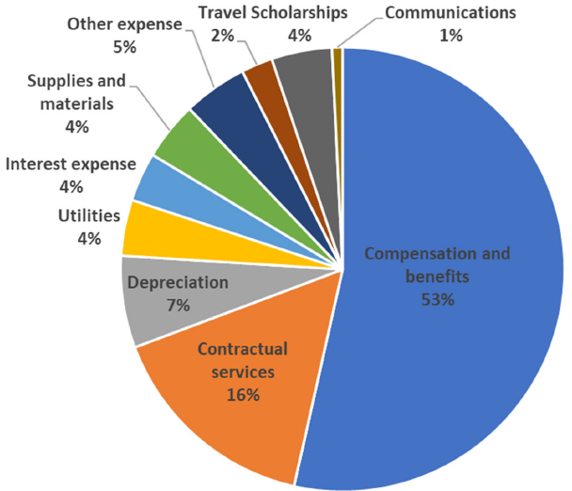
FY24 Budgeted Uses of Funds
Total Expenses = $1.17 billion

Slide 8
Survey Question #1
Q: The next graph shows the trends in OU’s budget from 1980 to 2020. In 2020, 12% of OU’s budget came from state appropriations. In 1980, what percent of OU’s budget was from state appropriations?
38%
48%
58%
68%
Answer: A, 38%
Notes:
Answer: A, 38%

Slide 9
Operating Budget Source of Funds Trend

Slide 10
Revenue Sources
The university’s central budget, which primarily funds faculty, academic staff, administration (e.g., Human Resources, Finance, Marketing, President’s Office, etc.), and operations (e.g., utilities, information technology, landscaping, etc.), is primarily funded from tuition and fees and state appropriations. Other large revenue sources are Auxiliaries (e.g., Athletics, Housing & Food, Parking, etc.), which are designed to be self-supporting and typically do not fund the central budget, and Grants & Contracts, which represent pass-through transactions, as revenues from Grants & Contracts always equal expenses from Grants & Contracts. Grants & Contracts are not a profit source for the university.

Slide 11
Changes in Key Revenue Sources
This graph compares, on a cumulative basis, the percent change in UG tuition and mandatory fee rates and state appropriations to the Higher Education Price Index (HEPI), which is used across higher education to project future budget increases required to preserve purchasing power. The FY23 and FY24 HEPI has not been published, so current Consumer Price Index rates were used. *HEPI rate used is for public, doctoral granting universities.
Notes:
This graph shows the CUMULATIVE change in tuition and mandatory fee rates and state appropriations funding.
If State Appropriations kept with inflation since FY10, OU Norman would receive about $67M in additional funding than we will in FY24.

Slide 12
Tuition and Fees
Tuition and Fee rates are set annually in May/June by the Board of Regents and then submitted for approval to the State Board of Regents for the coming fall. Tuition and mandatory fee rates for undergraduate and graduate students must comply with 70 O.S. 2004 Supp., Section 3218.8 that states resident rates must be less than the resident average of Big 12 Public Institutions and non-resident rates must be less than 105% of non-resident average of Big 12 Public Institutions. The university also charges some fees classified by the State Regents as non-mandatory and thus, are not part of the tuition and mandatory fee analysis reference above.

Slide 13
Net Tuition & Fee Revenue Trend
Notes:
OU Online (excluding Law) made up about $40M of revenue in FY23, up from $29M

Slide 14
Net Tuition and Fees per Freshman
From Academic Year 2017-18 to 2022-23, the annual cost of net tuition and fees for an incoming freshman have declined by $617 (or 6%) for residents and increased $181 (or less than 1%) for nonresidents.
Annual Net Tuition & Fees per Freshman
Notes:
Source: Bradley Cook Tableau Report from Banner
See Brad Cook email on 2-15-23, which included the Charges by Admit Year 2-15-23 report

Slide 15
Survey Question #2
Q: Student headcount at OU has grown by what percent over the last 10 years.
3%
7%
10%
15%
20%
Answer: B, 7%
Notes:
Answer: A, 3%

Slide 16
Student Headcount Trend
28,541
28,582
28,052
28,320
29,166
27,303
27,278
27,445
27,937
28,089
27,782
Note: Headcount above includes Norman Campus, OU-Tulsa Norman Campus Programs, and Extended Campus (primarily online classes offered through the College of Professional & Continuing Studies).
Notes:
Fall Enrollment Analysis from: https://www.ou.edu/irr/data-center/enrollment-statistics

Slide 17
Student Retention and Graduation
Fall Start
*
*
Note: Students included in the report above are first-time, full-time freshmen.
* Available later in CY 2024.
Notes:
Student Retention Survey Question
Student Debt Survey Question
By comparison, OSU's First Year Retention rate is 84%, while their 6‐Year Graduation Rate is 65% (both from prior year, as this is the
most recent data publicly available for OSU).

Slide 18
Survey Question #3
Q: Approximately how much additional tuition is generated from a 1% increase in the student retention rate?
$50,000
$200,000
$400,000
$600,000
Answer: C, $400,000
Notes:
Answer: C, $300,000

Slide 19
Survey Question #4
Q: What percent of first-time freshman graduate without any student debt?
25%
45%
55%
65%
Answer: C, 55%
Notes:
Answer: C, 55%
Average loan amount is $31,500 for those who do graduate with debt

Slide 20
Student Debt Information
Reporting Period | Percent Graduating with Debt | Average Debt per Borrower
2022-23 | 45% | $31,694
2021-22 | 46% | $31,521
2020-21 | 46% | $31,823
2019-20 | 43% | $30,258
2018-19 | 43% | $30,641
2017-18 | 45% | $29,283
Note: According to the Associate of Public and Land-Grant Universities, 58% of undergraduate students at four-year public universities graduate with debt, compared with 45% at OU.
Source: Data from table above is for first-time, full-time undergraduate students who entered the university as a freshman. 2017-18 to 2021-22 information is from the Common Data Set, as reported at https://www.ou.edu/irr/data-center/common-data-sets. 2022-23 data is from Office of Financial Aid, as Common Data Set information for 2022-23 has not been publicly released. 2022-23 data is for graduates in 2021-22.
Notes:
First stat under table I from: https://www.aplu.org/our-work/5-archived-projects/college-costs-tuition-and-financial-aid/publicuvalues/student-debt.html

Slide 21
Student Debt Peer Comparison
Source: Common Data Set for most recently reported data, as of August 2023.
Notes:
First stat under table I from: https://www.aplu.org/our-work/5-archived-projects/college-costs-tuition-and-financial-aid/publicuvalues/student-debt.html

Slide 22
State Appropriations

Slide 23
Budget Trends: State, OSRHE, OU-Norman
Over the last two decades, the State’s overall appropriation budget ($9.7B in FY23 – blue line below) has kept up with inflation (CPI from 1999 to 2023 = 83%). And while the appropriation to the State Regents has increased 22% over the last two decades, the appropriation to OU-Norman has increased 2%.
95% growth
22% growth
2% growth
Source: Oklahoma State Regents for Higher Education
Notes:
Andrea Flores provided

Slide 24
State Appropriation Trend
Includes Norman only; excludes OU-Tulsa and College of Law
Notes:
Includes only Norman; excludes OU-Tulsa and College of Law.
If State Appropriations kept up with inflation, Norman would receive $202M or $89M more than current.

Slide 25
State Appropriations per Student
At the AAU median, OU would receive $96M in additional funding annually
Source: Department of Education IPEDS database, FY20 (most recent year available). Most universities separately report their medical center, but not all, which can skew reported figures (e.g., North Carolina)
= AAU
= Non-AAU Public
Notes:
Public AAU* Average: $8,917 (median = $8,077)
Public Big 12** Average: $7,120
OU = $4,019 (requires $116M to bring us to AAU average and $73M to Big 12 average)
OSU = $4,122

Slide 26
Institutional Support Spend per Student (Administrative Costs)
At the Power 5 median, OU administrative costs would be $34M higher.
*
Source: Department of Education IPEDS database.
Note: Institutional support are expenses reported for overhead-type costs (e.g., President’s Office, Financial Support, HR, Development, Legal, etc.)
* OSU is investigating their reported Institutional Support spend, as no IT costs were reported, resulting in an unusually low per student spend level.

Slide 27
Key Financial Metrics

Slide 28
Key Financial Metrics
Composite Financial Index (CFI)
Unrestricted Cash
Total Debt
Bond Ratings
Notes:
CFI helps distill the financial position of the university

Slide 29
CFI Components
Balance Sheet Focus (70% weight):
Primary Reserve Ratio (35%)
How do our reserves compare to annual spend?
Viability (Solvency) Ratio (35%)
How do our reserves compare to our total debt?
Income Statement Focus (30% weight):
Return on Net Assets (20%)
How did we perform financially this year relative to our size?
Net Operating Revenues Ratio (10%)
Did we live within our means this year?

Slide 30
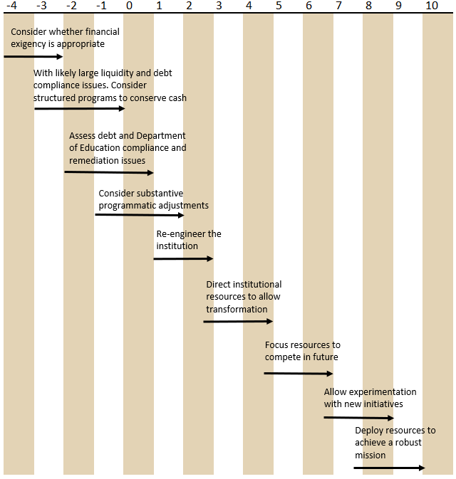
Charting the CFI Ratio

Slide 31
CFI Trend
CFI Rating
Source: Recalculated from Audited Financial Statements, OU Norman
Notes:
Increase in FY21 is primarily due to one-time change to our retiree health plan that shifted eligible retirees to the Medicare Advantage Plan.

Slide 32
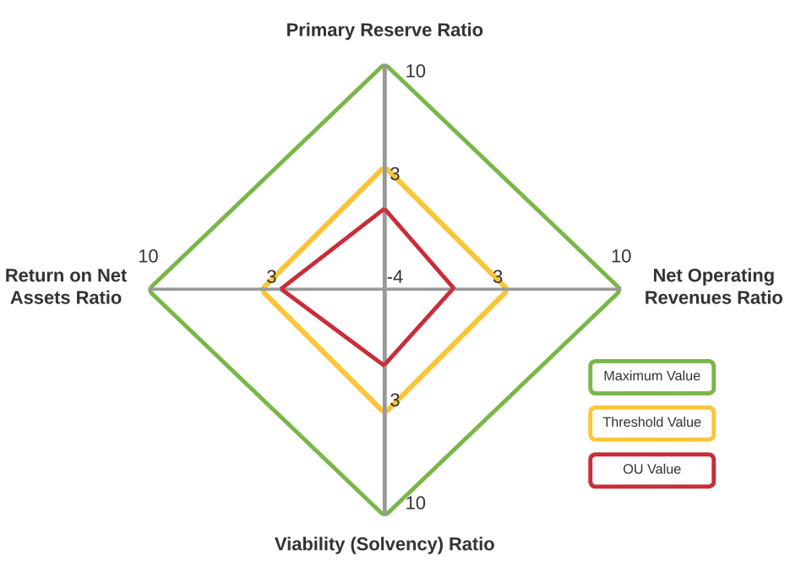
CFI Profile FY 2023
Takeaways: Income statement performance, buoyed by one-time gains, had driven the CFI’s strong performance in FY22 and FY21, but was more in line with historic norms. Balance sheet ratios strengthened slightly but continue to drag on the CFI score.
No threshold values are met.

Slide 33
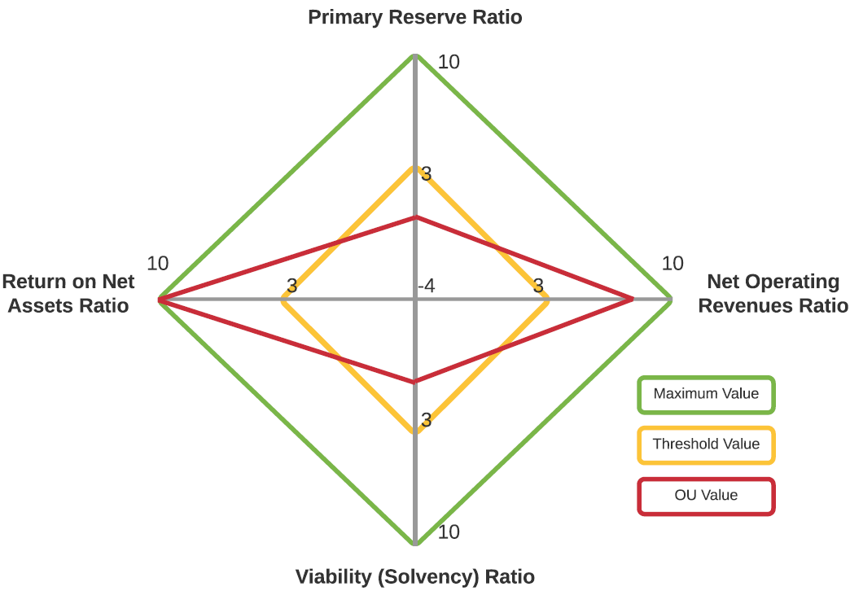
CFI Profile FY 2022
Takeaways: Income statement performance, buoyed by one-time gains, have driven the CFI’s performance. Balance sheet weakness continues to drag on the CFI score.
2 of 4 threshold values are not met.

Slide 34
2-Year Average CFI Comparison
CFI Rating
Avg.
Source: Recalculated from Audited Financial Statements (FY21 and FY22)
* These universities report at a System level, often combining health systems and other campuses.

Slide 35
Unrestricted Cash Metrics
Notes:
How do we maintain:
Faculty Impact
Community Impact
Student Success
Brand
Arkansas’ enrollment of Texas students has increased 221% since 2008. They now enrollment 500 more students from Texas than we do.

Slide 36
Days’ Unrestricted Cash on Hand
Days’ Cash on Hand
Source: FY09-FY22 recalculated from Audited Financial Statements, OU Norman; FY23 calculated using preliminary draft financials (Aug. 2023)

Slide 37
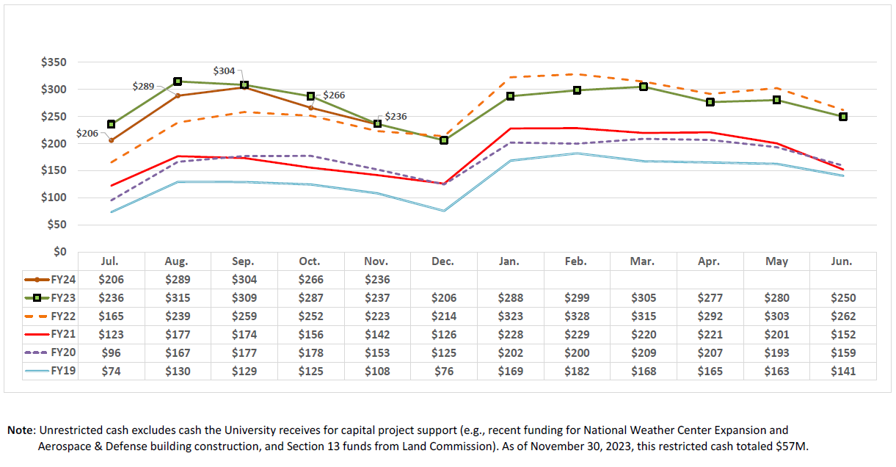
Unrestricted Cash Position (amounts in millions)

Slide 38
Cash Breakdown By Area
Note: Committed Central Funds includes funding for faculty recruitment ($17.4M), the fringe benefits pool ($45M), debt service ($2.6M), and contractually obligated loan and scholarship funding ($7.5M)

Slide 39
Total Debt
Notes:
How do we maintain:
Faculty Impact
Community Impact
Student Success
Brand
Arkansas’ enrollment of Texas students has increased 221% since 2008. They now enrollment 500 more students from Texas than we do.

Slide 40
Debt Trend & Outlook
FY24 increase from $175M in debt for housing/dorm construction and $60M for athletics projects. FY28 increase from $155M for housing/dorm construction. No other debt issuances are considered in the above graph.

Slide 41
Debt Breakdown

Slide 42
Debt Service to Operating Expense
Source: Recalculated from FY22 Audited Financial Statements.
* These universities report at a System level, often combining health systems and other campuses.

Slide 43
Bond Ratings
Notes:
How do we maintain:
Faculty Impact
Community Impact
Student Success
Brand
Arkansas’ enrollment of Texas students has increased 221% since 2008. They now enrollment 500 more students from Texas than we do.

Slide 44
Bond Rating History
Agency | Current Rating | Prior Rating
S&P | A+/Stable | A+/Negative
Fitch | A+/Stable | AA-/Negative
Credit Rating Classes | S&P / Fitch Ratings | Rating Description
 | AAA | Prime | Investment Grade
 | AA+ | High Grade
 | AA
 | AA-
 | A+ | Upper Medium Grade
 | A
 | A-
 | BBB+ | Lower Medium Grade
 | BBB
 | BBB-
Notes:
We’re currently the lowest rated university of the SEC and tied for the lowest in the Big 12.
Devon, Williams, OneOK and Southwest Airlines are all BBB or BBB+. Chesapeake Energy is below this chart.

Slide 45
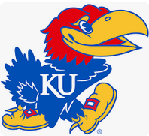
Big 12/SEC Credit Rating Comparison
A
A+
AA-
AA
AA+
AAA
Note: Investment Grade debt is rated BBB- and above (BBB- is five notches below A+). The rating above reflects the S&P rating. If an S&P rating was unavailable, Moody’s or Fitch was utilized.

