Slide 1
Building Resource Coordinator (BRC) Program

Slide 2
WELCOME
and
Thank you!!!
This Photo by Unknown Author is licensed under CC BY-NC

Slide 3
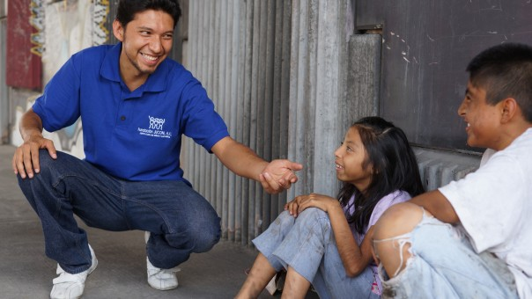
What is the BRC Program?
Provides support for people in every campus building by creating a network of knowledgeable people who can assist those around them by:
sharing resources
promoting training
contacting the appropriate authorities in situations that may impact their building(s).
This Photo by Unknown Author is licensed under CC BY
Notes:
OUHSC has an ERM committee that is charged with analyzing and managing high level risks in a manner that best serves the interests and missions of our campus. The Director of Enterprise Risk Management is the Chair of the ERM committee.

Slide 4
What does a BRC do?
Serve as primary Point of Contact to facilitate communication between building occupants and service providers by:
Posting information on emergency procedures and contact information
Assisting with the annual property survey for insurance assessment
Coordinating and/or requesting drills/trainings (30-day advance notice)
Identify, report and monitor:
Problems within and around the building (power outages, flooding, repairs, building access needs, etc.)
Safety hazards (blocked exits, dark hallways, water leaks, and EXIT signs that are not illuminated, etc.)
Damage that results in or from property claims
Retain copies of building floor plans
Notify emergency personnel of building occupants that need assistance or hazardous materials within the building
Notes:
Incident reported – work with the department and SRM and Legal to handle claims. Often, nothing comes from these claims but we have put the proper parties on notice. Sometimes these are claims against the University sometimes these are claims the university has against a third party. *Important to report incidents when they happen.
*Proactive notice

Slide 5
What a BRC does not do
BRCs are NOT required to:
Move anything
Put themselves in danger
Search buildings in an emergency
This Photo by Unknown Author is licensed under CC BY-NC-ND

Slide 6
OU Resources on your team!
Fire Marshal
Campus Safety
Facilities Management
Environmental Health and Safety
OU PD
Behavior Intervention Team (BIT)
OU IT
Space Management
Architectural and Engineering Services
OU Advocates
Enterprise Risk Management
Notes:
Implementing, coordinating insurance (coverage, questions, contracts, leases, do you (or the University) need to buy more, explaining what types of things are and are not coverage under the OGTCA, when we do purchase insurance we assist with those RFP’s and go to the market).

Slide 7
Enterprise Risk Management
Property Survey
Claims
Third party Incidents
Workers’ Compensation
Minors on Campus
Contact us to set up a Risk Management Road Show for your building or department!!!
Notes:
ERM inspects new space we are leasing or buying.
Inspect space after an incident/accident has occurred;
Reinstituting regular inspections of OUHSC buildings on campus. JR will work with BCs.

Slide 8
Norman ERM TEAM
General e-mail…………….norman-riskmanagement@ou.edu
General Phone number …………………….......(405) 325-2490
Cathy Krane, J.D.
Director of Enterprise Risk Management
(405) 325-5695, cathykrane@ou.edu
Carrie Clark
Workers’ Compensation Specialist
(405) 325-0866, carrieclark@ou.edu
Zinah Dupree
Risk Coordinator
(405) 325-5433, zinahdupree@ou.edu

