Slide 1
OU Marketplace Training

Slide 2
Roles
Shopper
No prior access required. Automatically available to University staff.
Select goods and create carts.
Cannot process or encumber budget.
Requester
Must access the system through PeopleSoft eProcurement module.
Inherit all Shopper roles with additional abilities to convert carts to PeopleSoft requisitions.
Responsible for encumbering budget for orders and submitting for approval.
Notes:
Roles overview

Slide 3
Suppliers
IT Equipment
B&H Photo Video
CDW-G
Dell
Insight
Lab Supplies
Bio-Rad
Fisher Scientific/Life Technologies
Medline
Qiagen
Sigma-Aldrich
VWR
Office Supplies
Complete Book
OU Printing Services
Staples
Maintenance Materials and Supplies
Fastenal
Grainger
MSC
*New suppliers are added periodically. If there are any that you would like to see added to Marketplace, email them to oumarketplacesupport@ouhsc.edu
Notes:
List of current suppliers

Slide 4
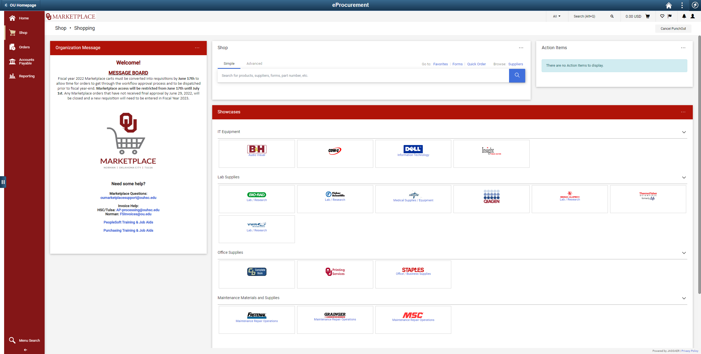
Navigating Marketplace

Slide 5
Punchout Catalogs
Notes:
Most of the action in Marketplace happens here. Each catalog is a supplier that has been competitively bid.
Punching out takes the user to the supplier’s website custom built for the University where they can shop, add items to their cart, and return to Marketplace.

Slide 6
Direct Search
Notes:
Allows users to directly search by keyword, manufacturer part number, supplier, etc.
Live pricing is being added to some scientific vendors, allowing price comparison and adding to cart without using Punchouts.

Slide 7
Action Items Menu
Notes:
Where you can quickly view assigned carts.

Slide 8
Organization Dashboard
Notes:
Periodic updates from purchasing regarding the Marketplace along with contact info and training links.

Slide 9
Profile Updates
Notes:
Where you will update your ship-to defaults.

Slide 10
Marketplace Menus
Notes:
Main navigation in Marketplace to see carts and orders.

Slide 11
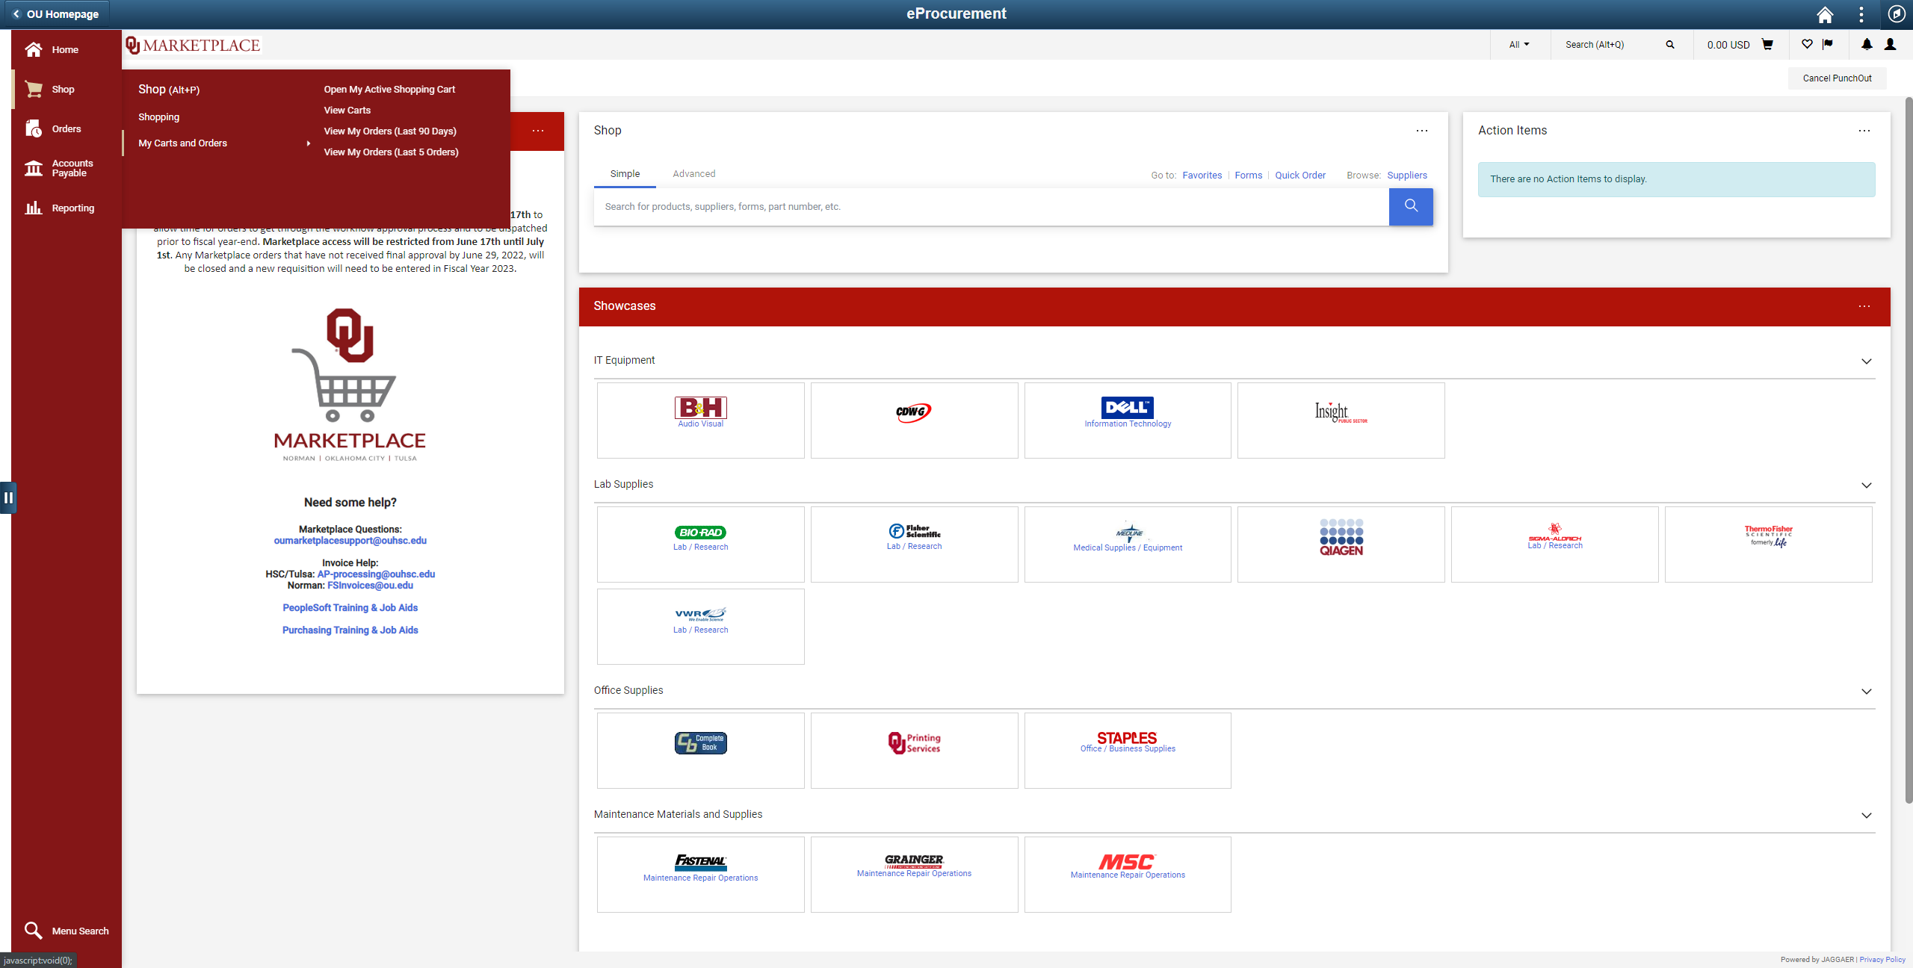
Shop Menu
Notes:
Where you can view past orders and view carts.
Note: This is where substitutes can be assigned and unassigned. Additionally, assigned carts and draft carts can be viewed here.

Slide 12
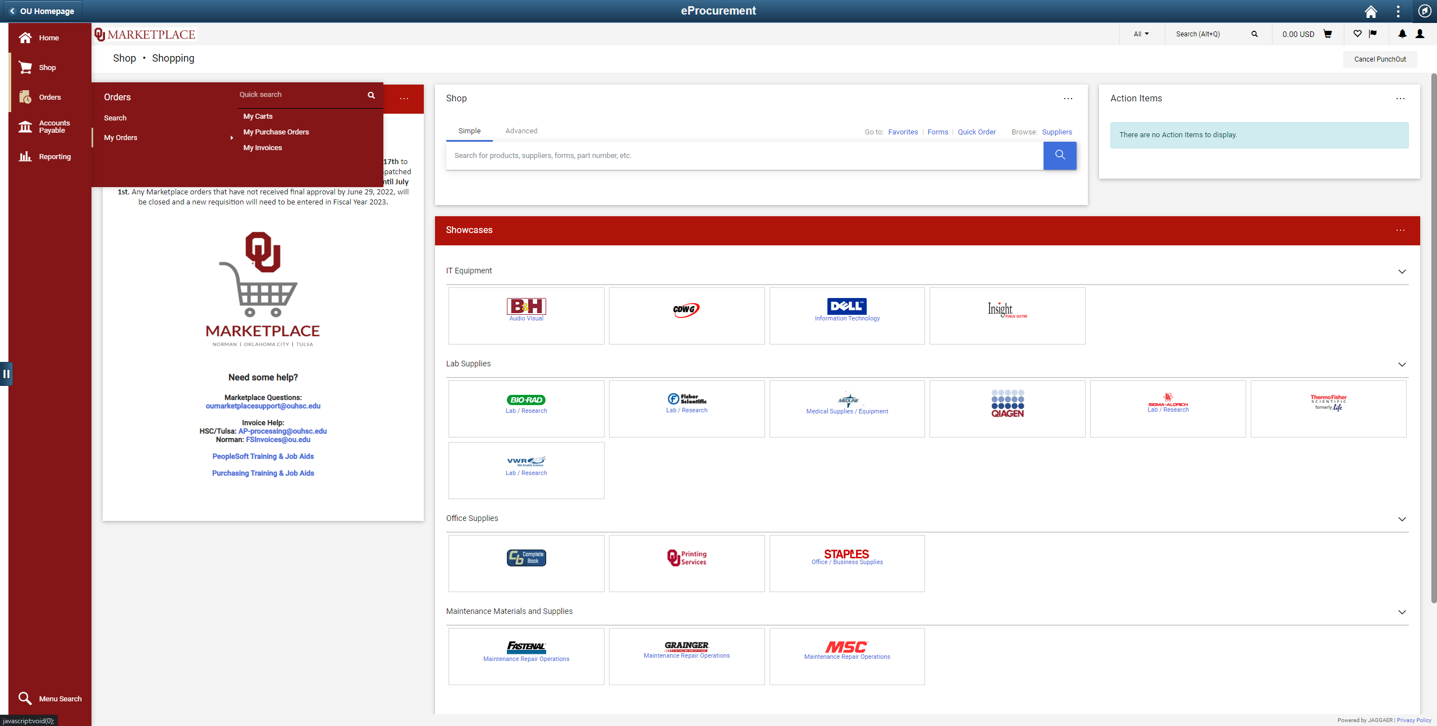
Shop Menu
Notes:
Use this menu to view everything a user has added to the system.

Slide 13
Marketplace Carts - IT Equipment Notice
IT Equipment Shipping Location
All NORMAN computers MUST ship to 2750_0003 for setup before being sent to the end user.
All HSC and Tulsa computers MUST ship to your departmental Tier 1 for setup before being sent to the end-user.
For updates on the computer standardization policy or more information, visit the OU IT site: ou.edu/ouit/computer_standardization

Slide 14
Marketplace Carts - Non-Catalog Purchases
If a good is not in the supplier catalog – such as a custom computer or special lab equipment – a quote can be requested from the vendor and loaded into Marketplace.
Most vendor contacts are listed on the punchout.
Most punchout catalogs have a “quotes” section, but the vendor contact will have more expertise in their specific punchout if needed.
Quotes are handled just like other carts and must go through approvals before being sent to the supplier.

Slide 15
Marketplace Requisition - General Notices
Marketplace Requisitions and Special Request Items
Marketplace requisition items CANNOT be combined with regular requisition items.
Approval routing and dispatch methods vary.
Combining both will result in stalled approvals and a delay in receiving ordered goods.
Marketplace Requisitions can have Multiple Suppliers
Marketplace orders, unlike regular orders, can have multiple POs sent to multiple suppliers.

Slide 16
Marketplace Requisitions – PO Dispatch
Batch Process
Every 30 minutes
Monday – Sunday
8:00 AM – 4:30 PM
Email to Requester and Shopper notifying them that the PO is with the supplier

Slide 17
Marketplace Requisitions - Change Orders
No Change Orders for Marketplace Goods
Vendors aren’t notified of Marketplace order changes.
Any changes to a Dispatch Marketplace order must be coordinated with the vendor.
Any cancellations must also be requested from the vendor before the order can be closed in Marketplace.

Slide 18
Marketplace Requisitions - Credits
Credit Memos cannot flow through Marketplace due to State Account restrictions
Departments can request a return through the supplier
Refunds must be credited by check and mailed to OUHSC Accounts Payable to credit back to department accounts. This is true for both campuses

Slide 19
Marketplace Next Steps
Completion of training to gain security access
apps.ouhsc.edu/FinancialServices
Purchasing Financial User
Departmental Purchasing Entry
Once IT Security has added access, users can access Marketplace through PeopleSoft. DO NOT access the system as a shopper.

Slide 20
Additional Questions and contact
Marketplace Questions:
oumarketplacesupport@ouhsc.edu
Purchasing Website:
ou.edu/Purchasing
Purchasing Staff Directory:
ou.edu/Purchasing/Staff_Directory

