Slide 1
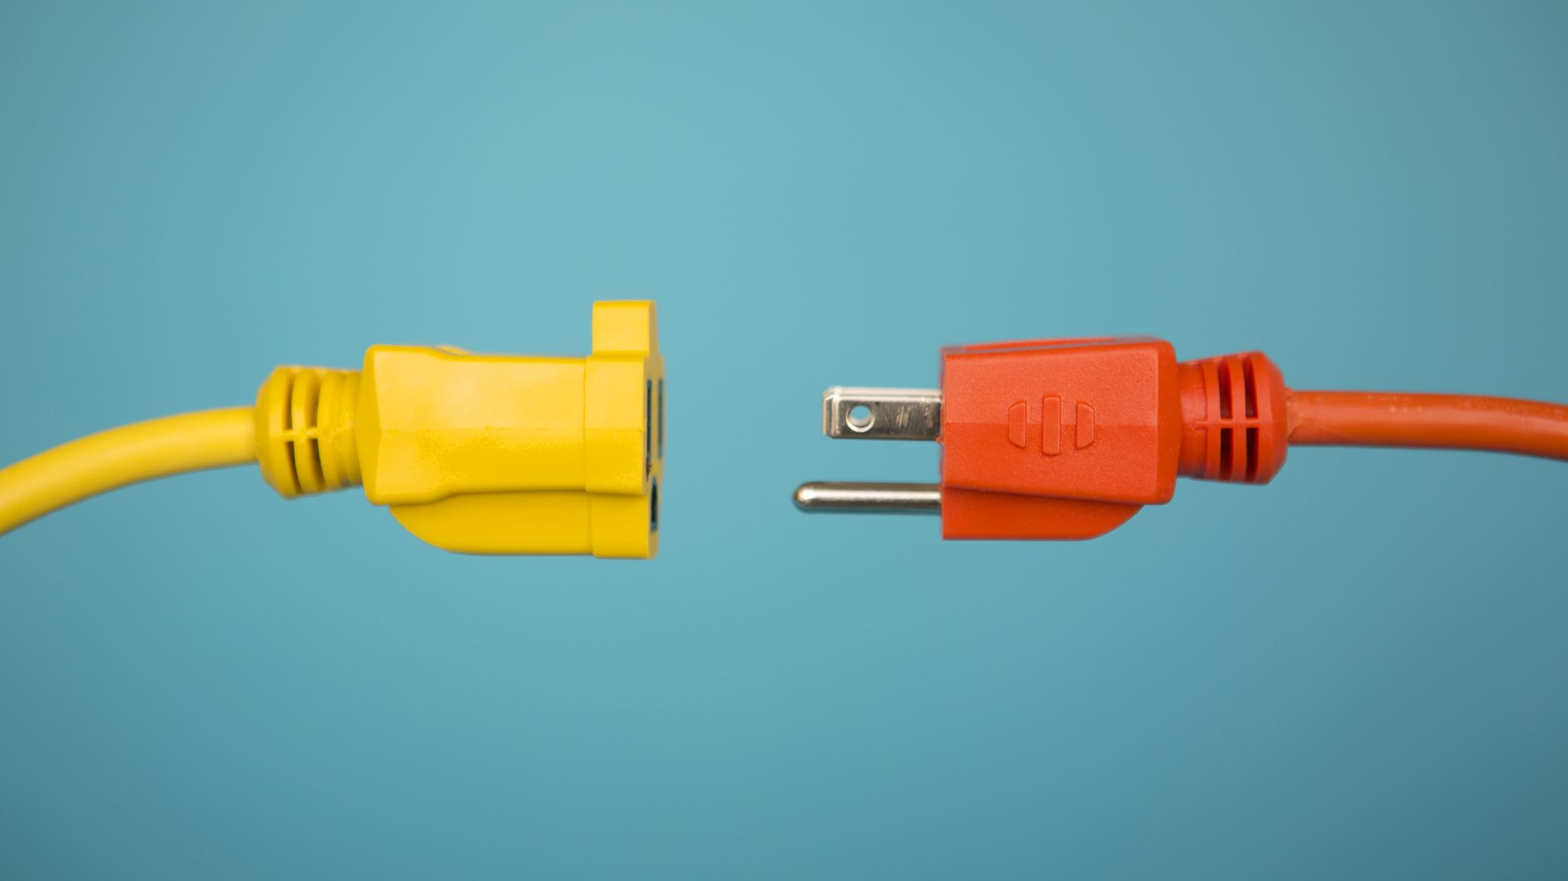
electric vehicle charging Stations
EVSE | Electric Vehicle (EV) Charging Stations | ChargePoint

Slide 2
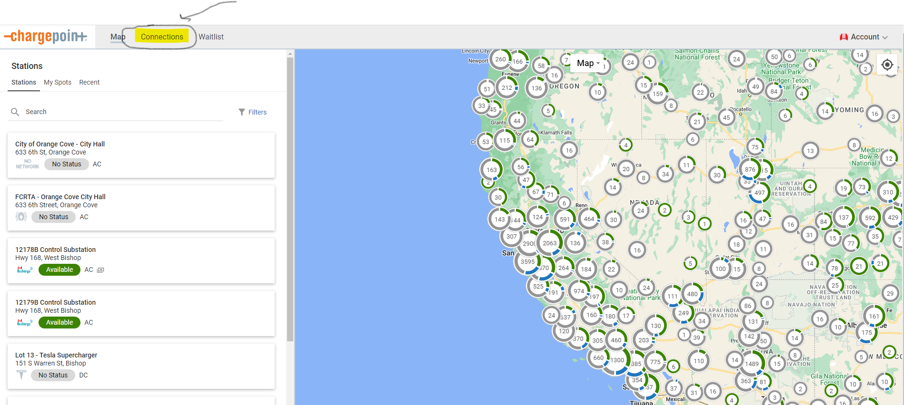
Once you log into your charge point account, you will click on the Connections tab in the upper Left corner.

Slide 3
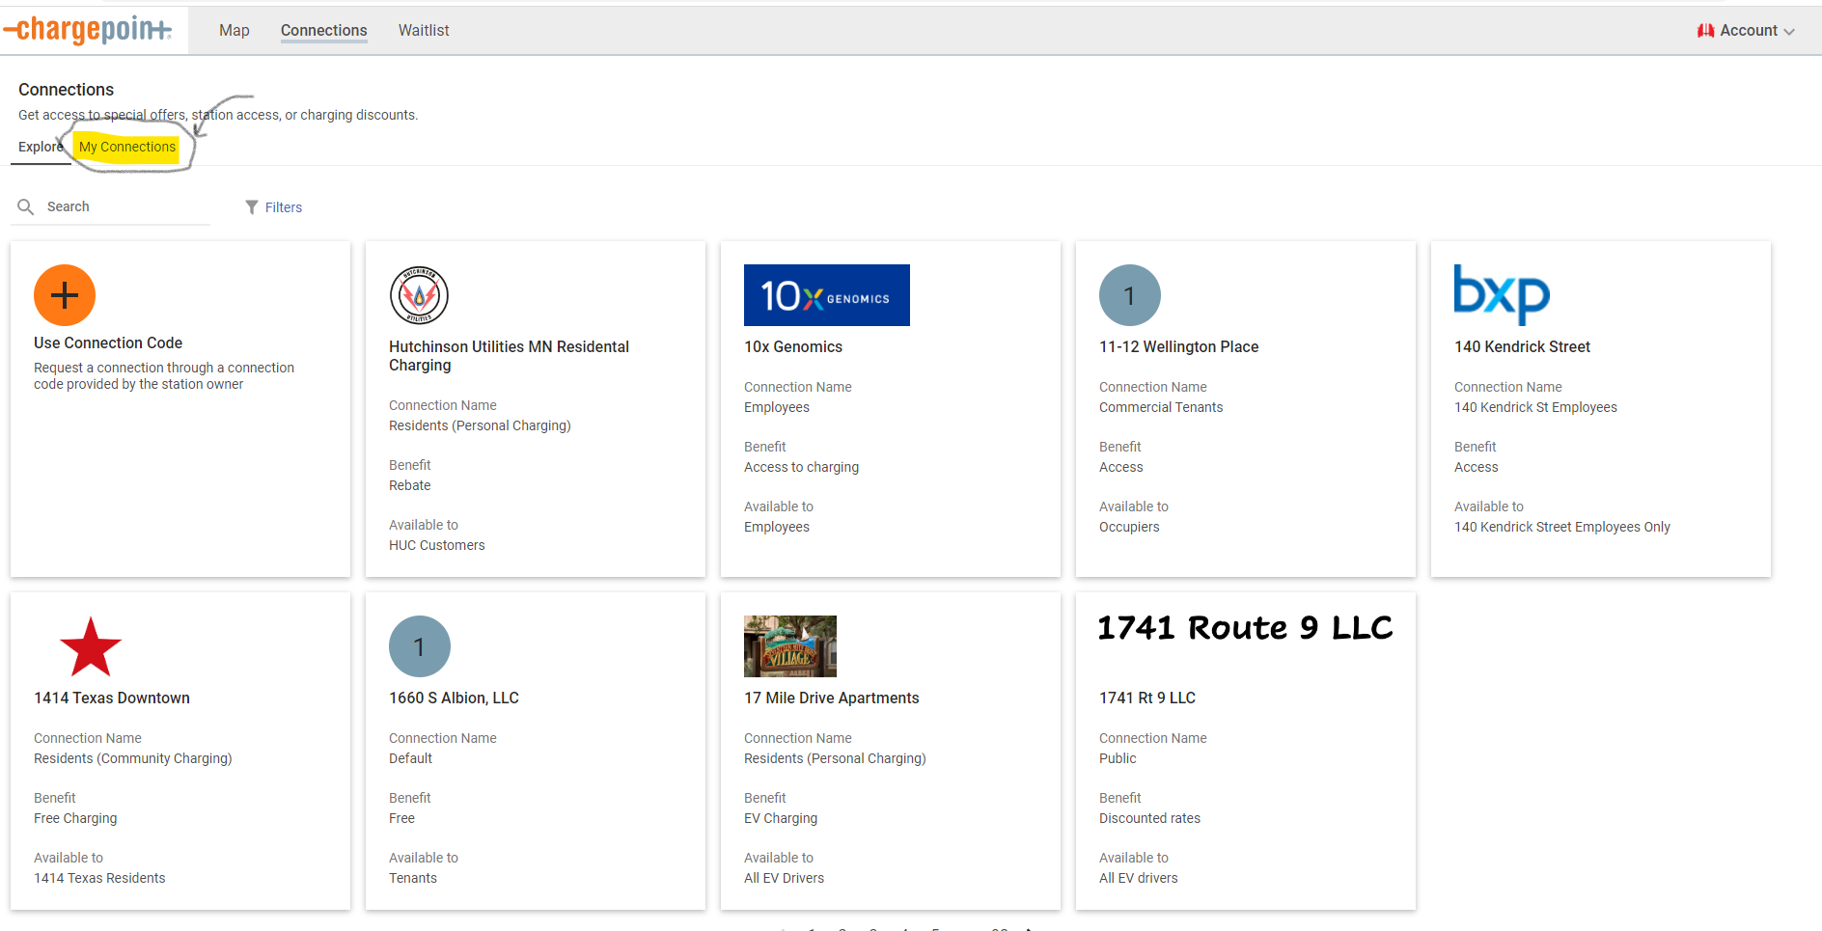
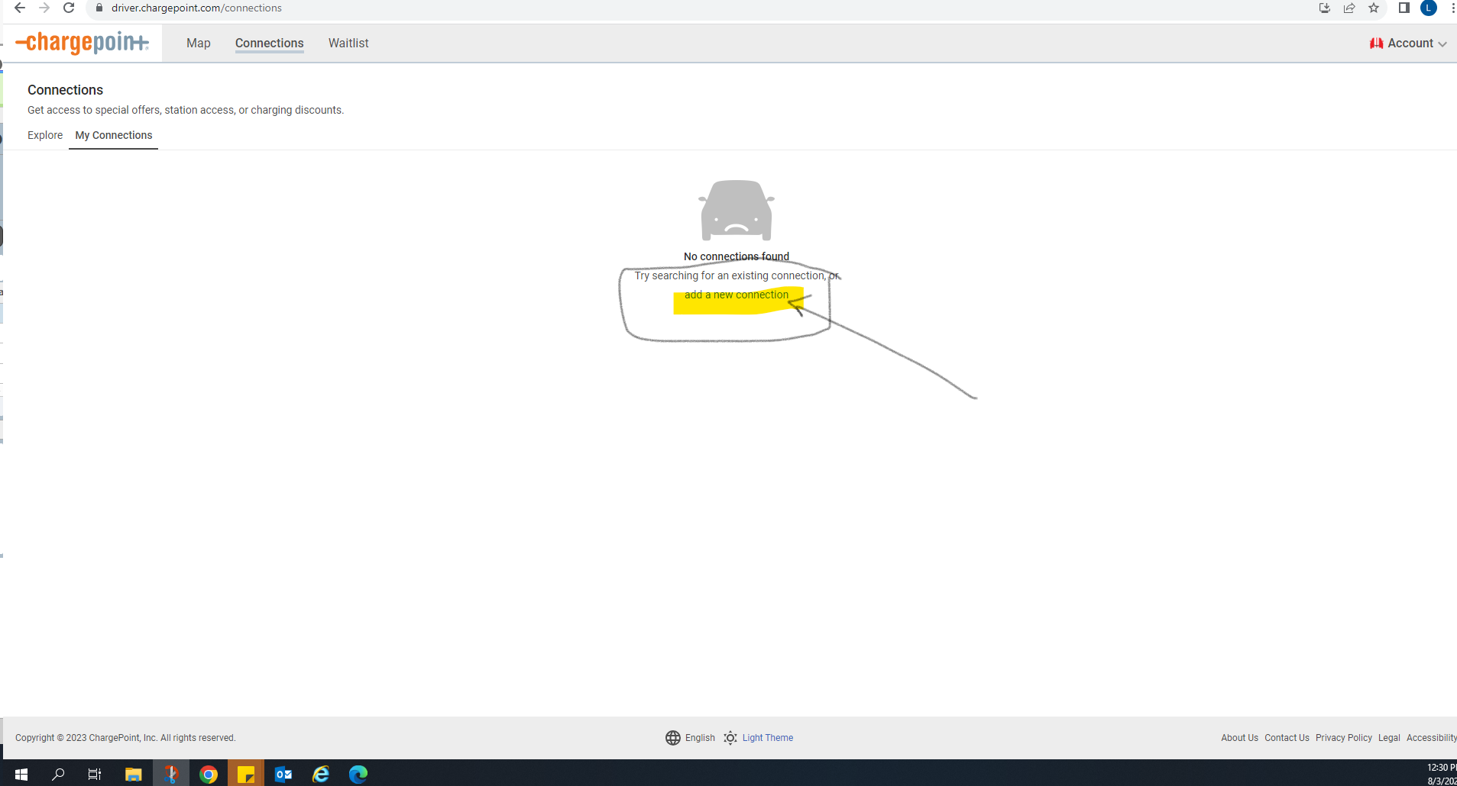
Click on the My connections tab in the left hand corner, then click add a new connection.

Slide 4
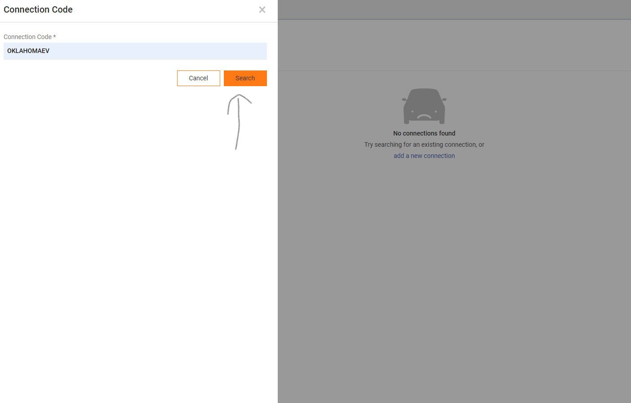
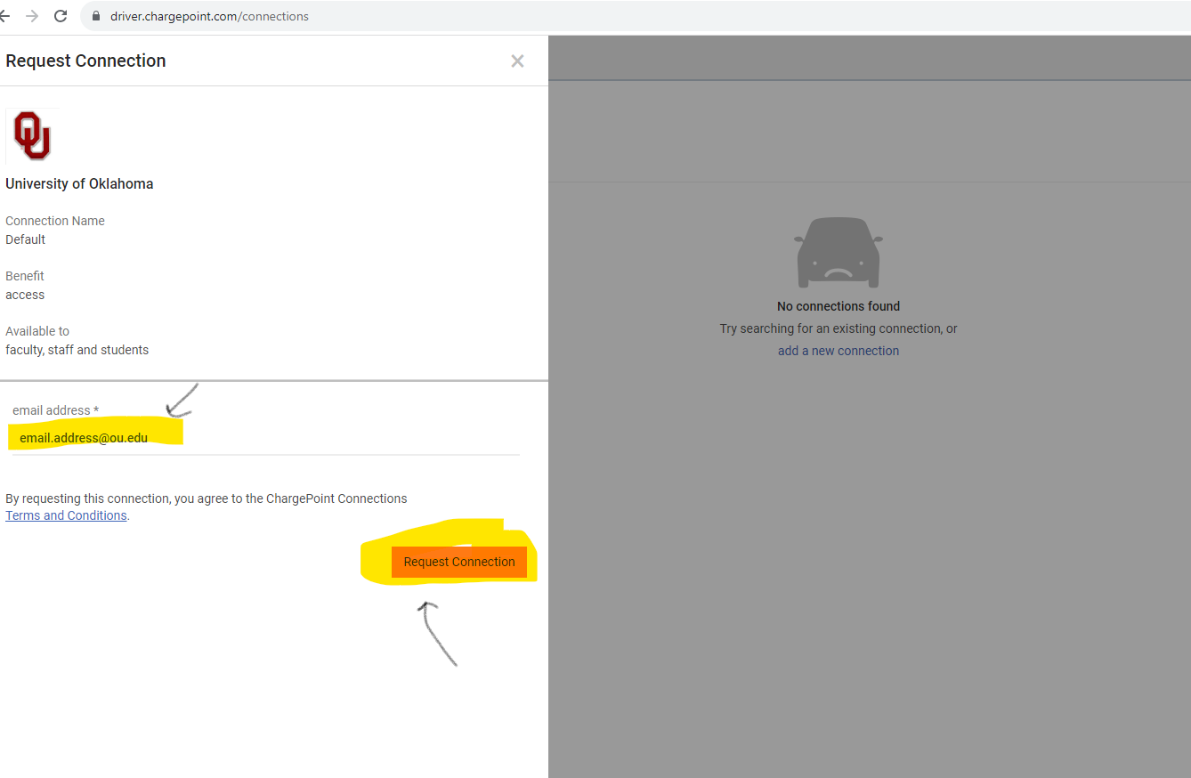
the connections code OKLahomaev.
Add in your ou.edu email address then request connection.

Slide 5
This will send the request to parking services to get approved. If you do not have access within 24 business hours please call us at 405-325-3311.

